Slide 1
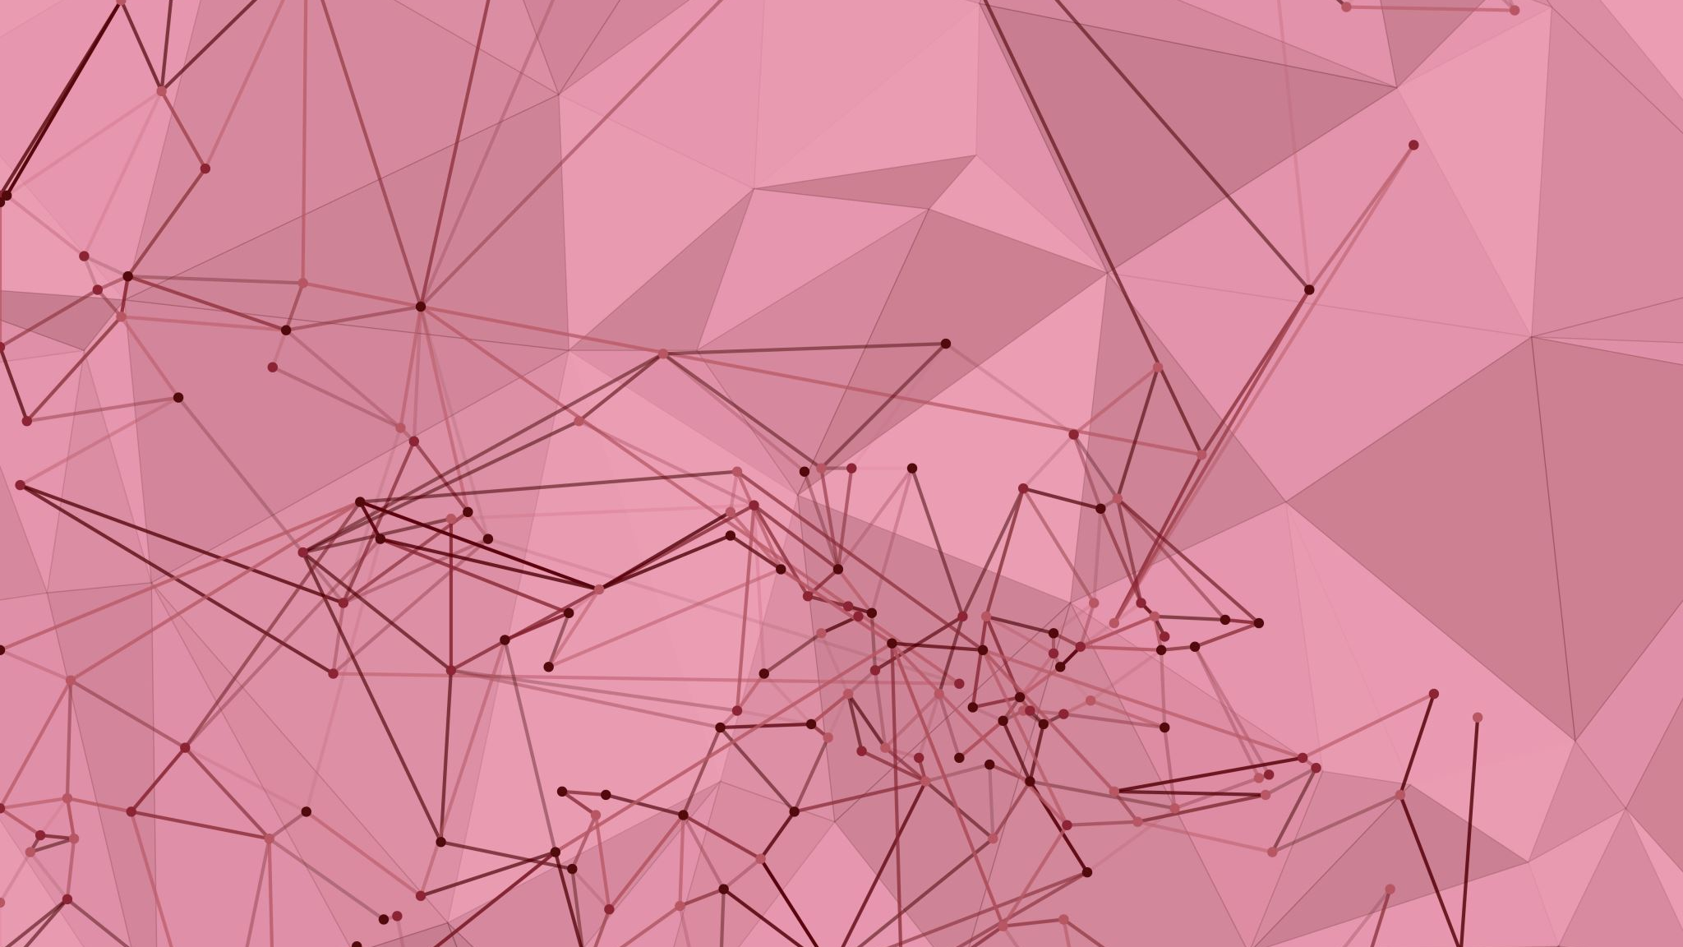
CS490 Final Presentation Bitcoin Wallet Transfers
BY: Zakery Hickey & Kamalakar Bulipe

Slide 2
Dataset and Collection
Blockchair Rest API
https://blockchair.com/api
Main workflow
Request blocks from blockchain
Parse all transaction hashes in blocks
Parse recipient & sender addresses, transaction amount in btc
Write data to .csv file
Parse .csv to generate nodes, edges, and direction for network

Slide 3
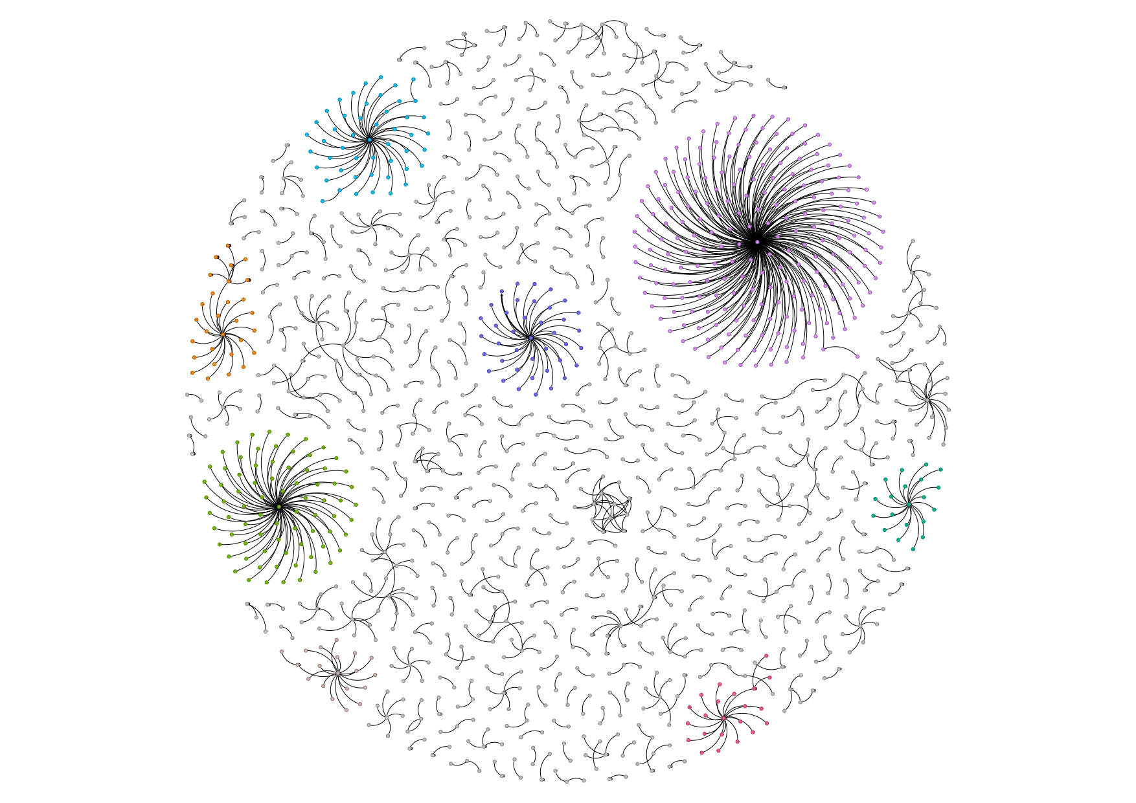

Slide 4
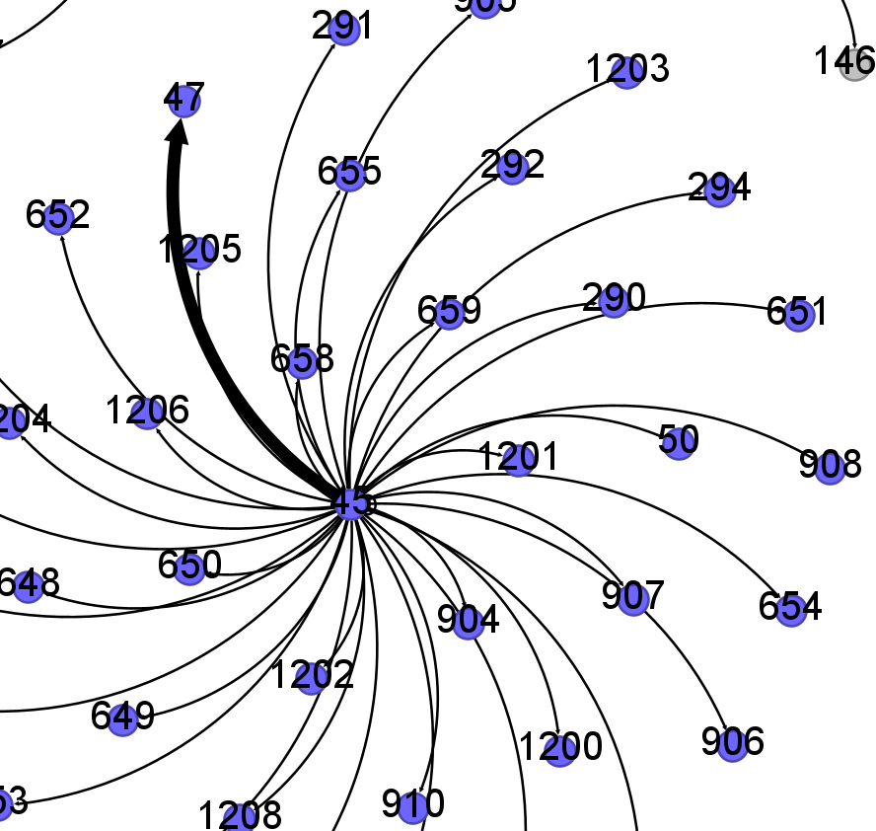
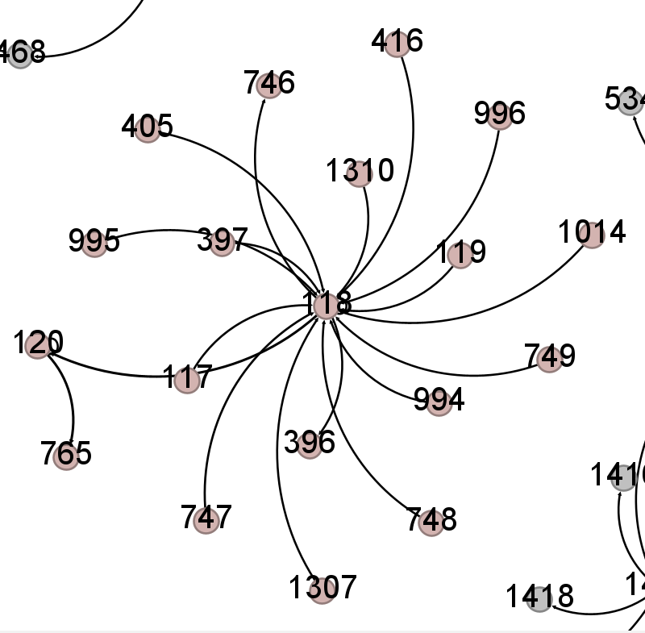
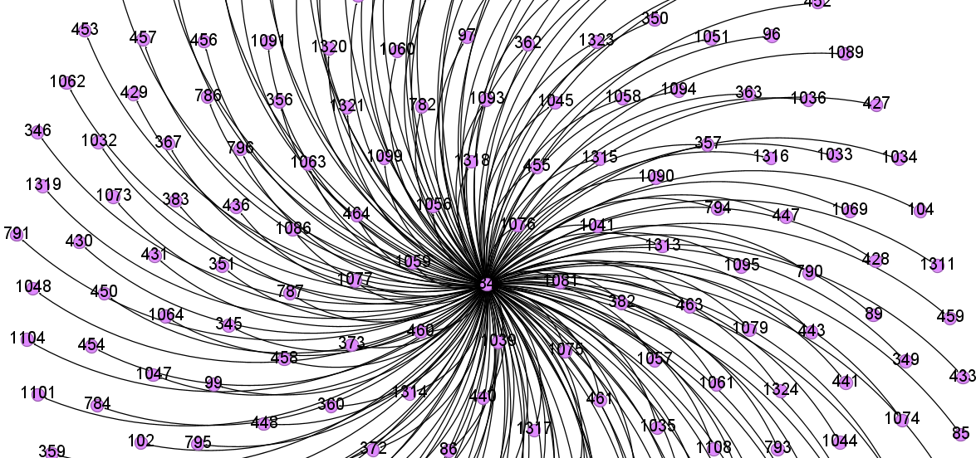
Important Nodes
Nodes 84, 45, 118
118 Highest Betweenness Centrality at 56
45 has highest weighted edge with a btc valued at over $3,000,000
84 is a wallet sending the exact same btc value to over 100 recipients at the exact same time.

Slide 5
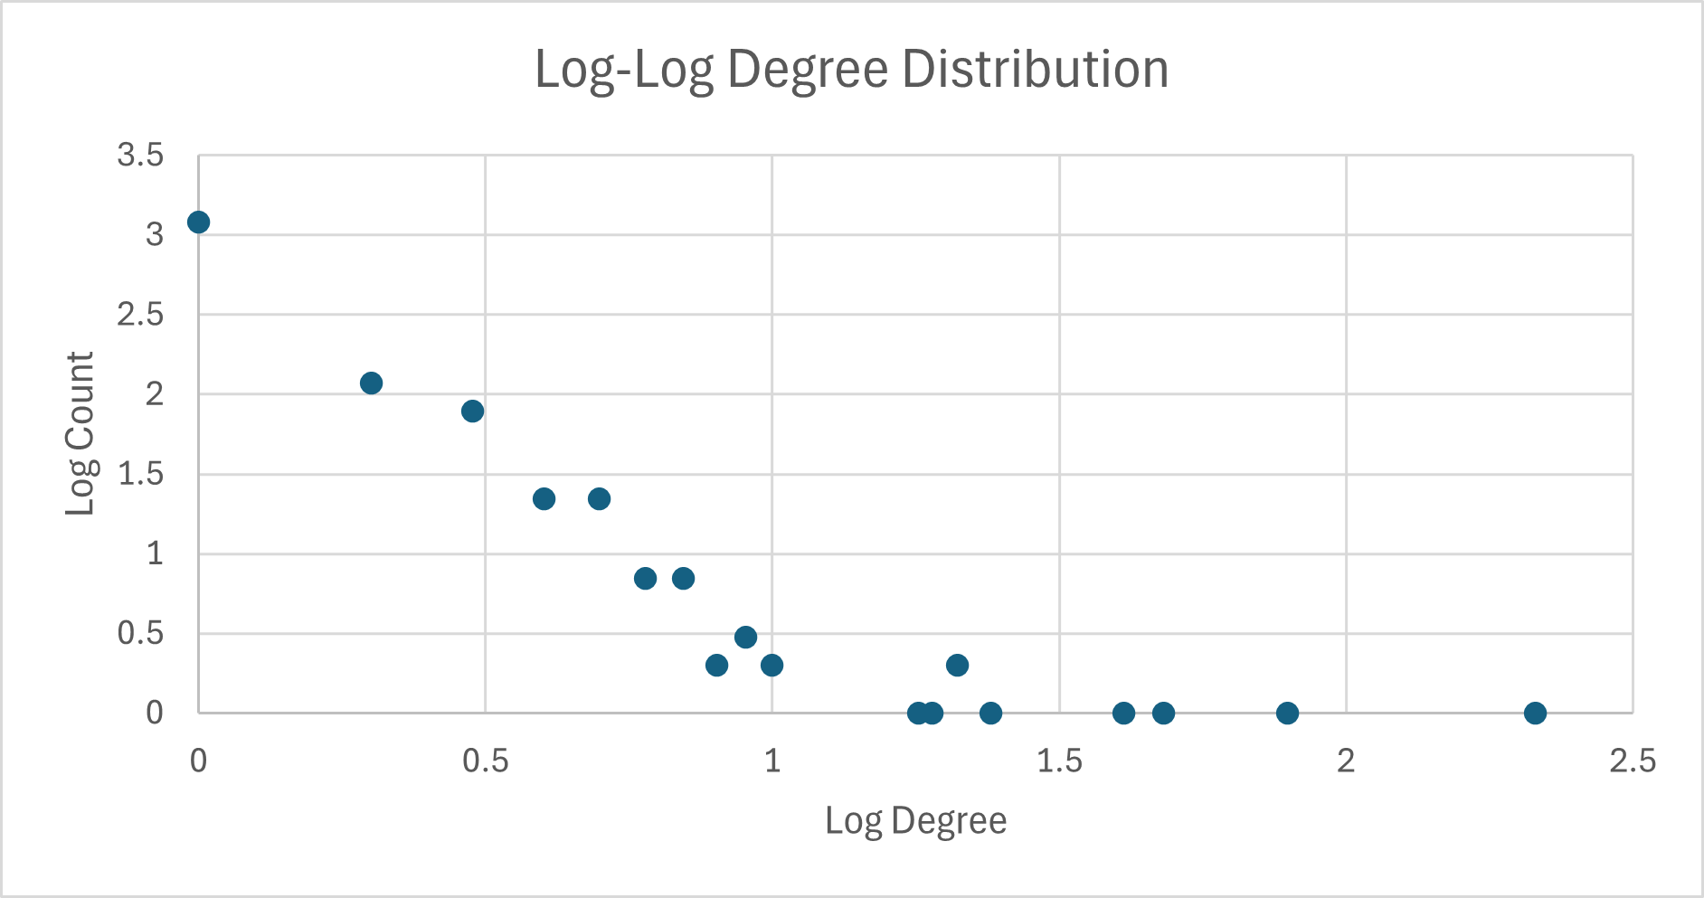
Properties of the network
Directed Graph
1469 Nodes, 1252 Edges
Average degree: 0.852
Diameter: 4
Clustering Coefficient: 0.03
Average Path Length: 1.191
Degree Distribution with heavy tail

Slide 6
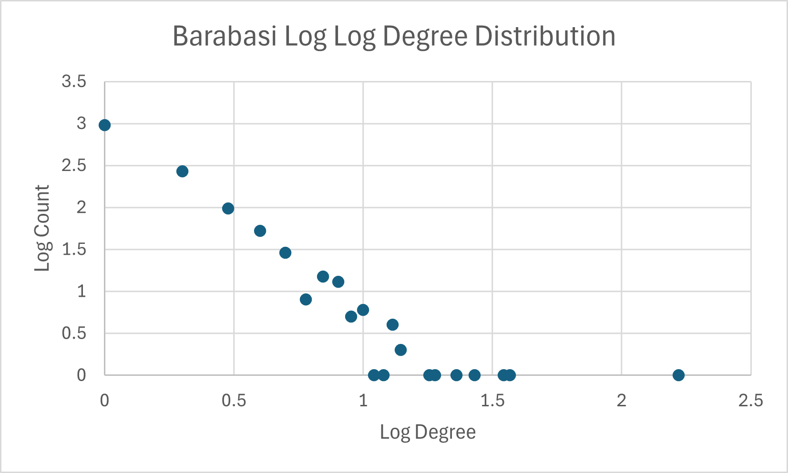
Comparison with other Networks
2 random networks generated and compared to real network
The real network had higher clustering coefficient, lower average degree, and shorter avg path length
Randoms clustering coefficients were .005 and .001
Barabasi Scale Free Network
Closer properties to real network than that of random networks

Slide 7
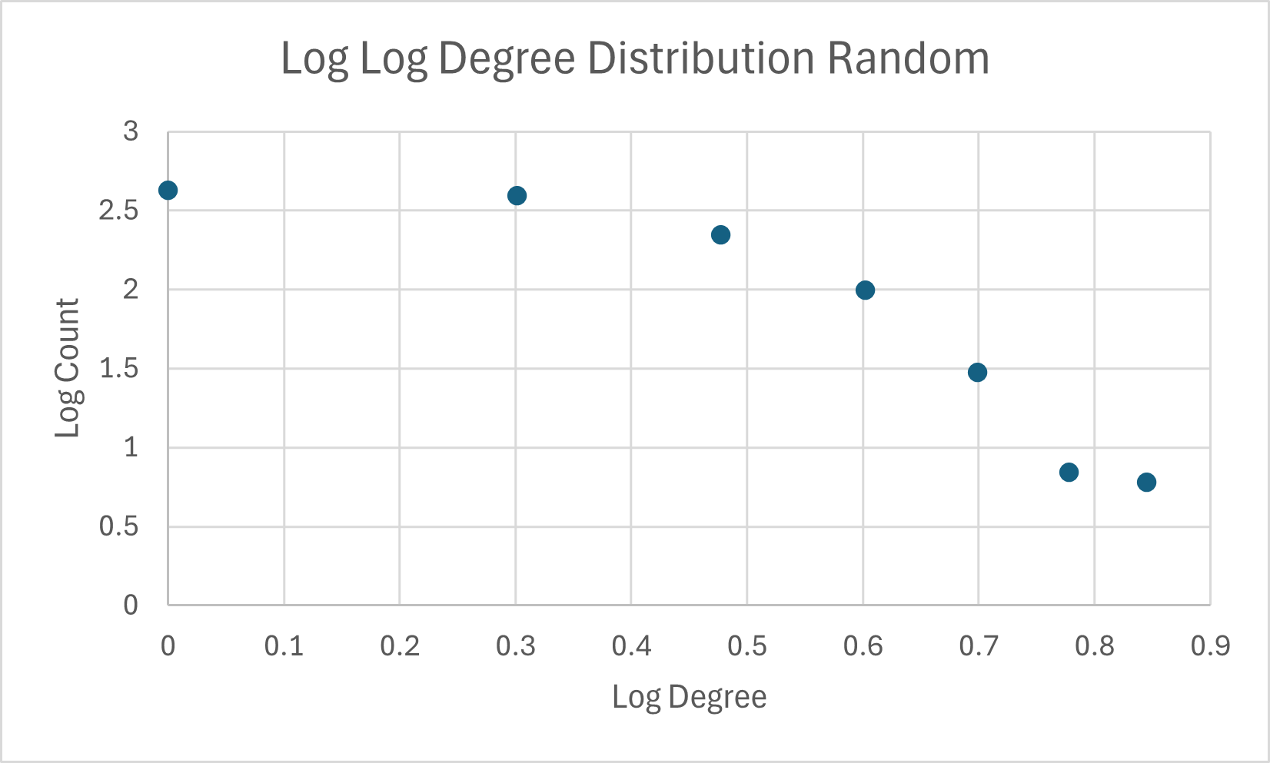

Slide 8
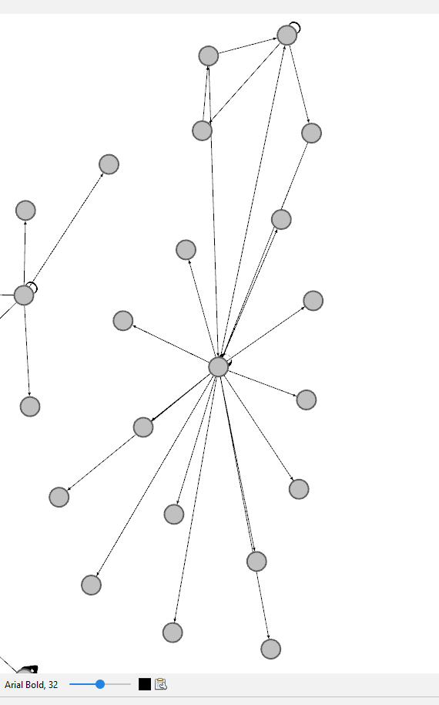
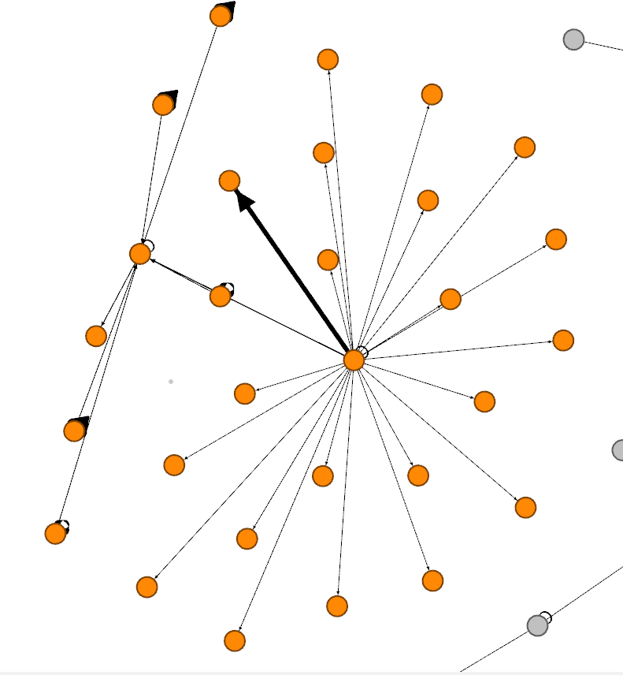
Clustering
Louvain communities
8 main communities making up all major hubs in network
Still only making up 32% of entire network
Not very robust as most of graph is made up of only a few major hubs that keep communities together
Visualizes all major transactions clearly

Slide 9
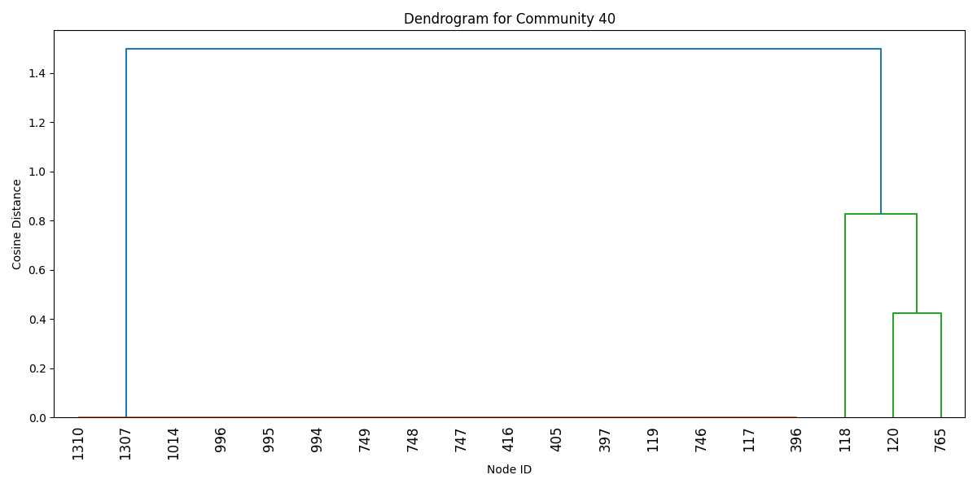
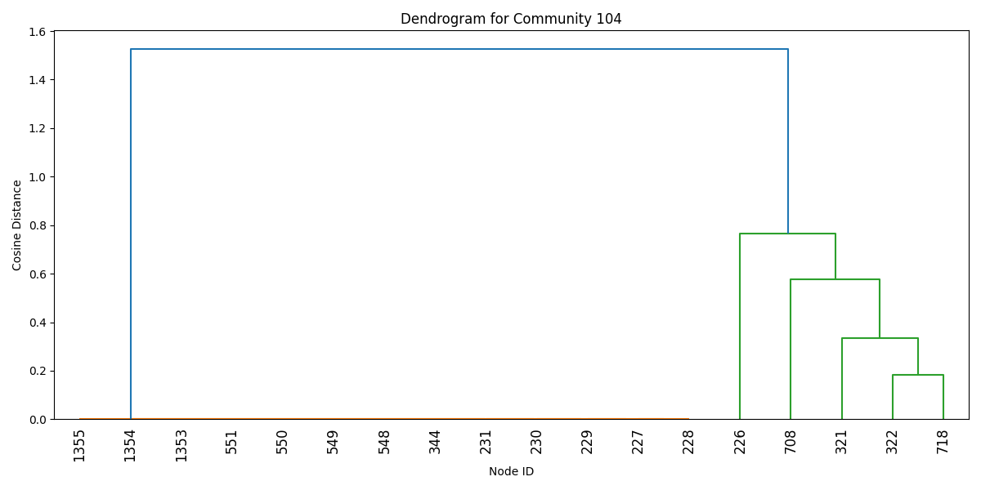
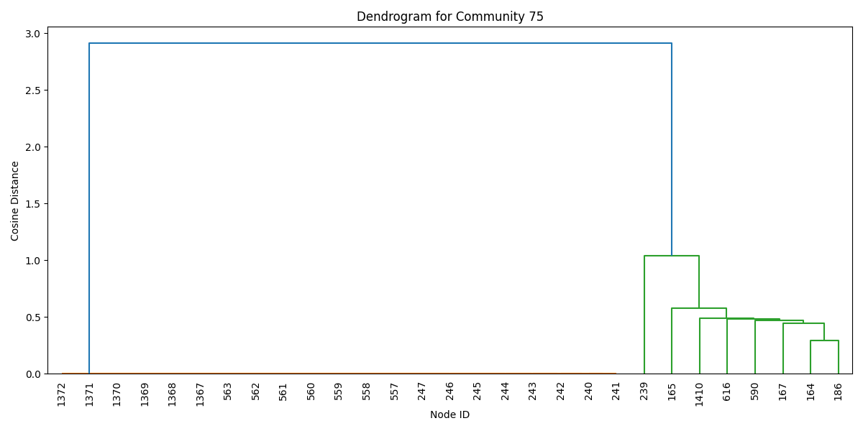
Intra Community Dendrograms
Very isolated network so opted for intra community dendrograms
Transaction hierarchal structure is very similar across network
All have two main sub communities
Left hand side cluster are nearly identical
Right hand side has smaller, tighter cluster

Slide 10
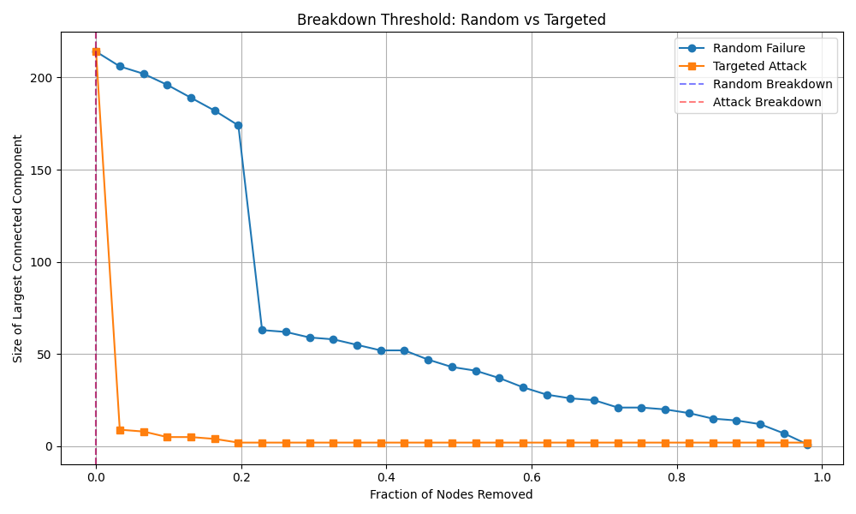
Random Failure vs Targeted Attack
Attacks are detrimental to network
Understandable since communities are only held together by the sender of funds.
Random failure points are still high risk since all it takes is hitting one of the main nodes in transaction to isolate many others

Slide 11
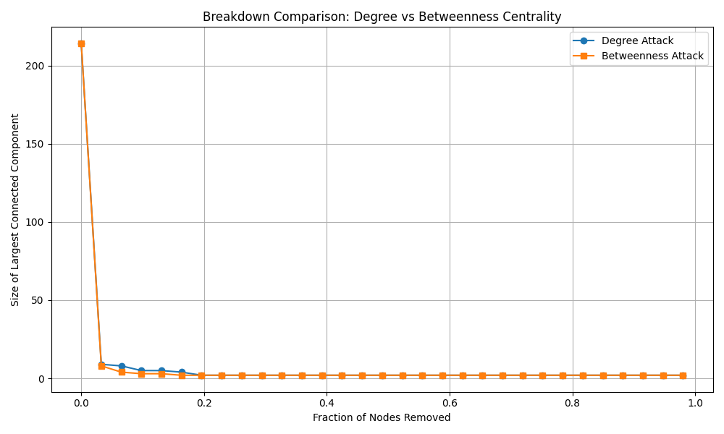
Betweenness Centrality vs Targeted attack
Both break the network down just as easily
Shows our network is very fragile and falls apart easily
Makes sense as the largest connected component is connected directly through transfers and would shatter regardless

Slide 12
Challenges
Bitcoin transactions include layers of obfuscation
Every transaction wallet hashes change
Creates very isolated communities outside main transaction(s)
Data locked behind API’s with paywalls
Very few free resources that lack data quality and quantity
Very isolated and sparse network
Required multiple comparisons to decide whether scale free capabilities
Creative analysis on clustering

Slide 13
Findings
Many transactions don’t go more than 1 to 2 degree
Lack of laundering paths to analyze
Reinforces fact that the network is highly fragile
Multiple large transactions sending exact same amount of bitcoin from dozens to hundreds of wallets
Since these data are wallet to wallet, most likely mixing is occurring here
Still cannot rule out other reasons such as automatic payouts or phishing
Analyzing these hubs shows massive transfers every few minutes
Wallet transfers are scale free

Slide 14

Applications of network
Any block in the blockchain can be analyzed to find major transaction hubs.
These hubs can be backtracked to find the wallet address and transaction hashes of senders/recipients and investigated.

Slide 15
Questions?

